Slide 1






Celebrating Sustainability and
Ecological Innovation in Iloilo

Slide 2
Cover Slide (Key Visual)
Initiative Title
Award Category
Name of LGU / Business / Organization

Slide 3
Instructions for Submission
This deck is intended to provide visual and documentary evidence of your initiative for the Green Guardian Awards evaluation. Keep it concise, visually engaging, and focused on key achievements and outcomes. It is recommended that you design your slides in your own style to best showcase your initiative. You may follow the outline provided.
Initiative Overview
One-line description of the initiative
Implementation period (Start – End / Ongoing)
Brief summary of objectives (3–5 bullet points)
Key Stakeholders & Partners
Names of organizations, teams, or communities involved
Roles and contributions
Logos/photos of stakeholders (optional)
Activities & Implementation
Photos of activities in action
Short captions describing each activity
Beneficiaries & Reach
Photos of beneficiaries or participants
Numbers reached (households, employees, students, community members)
Short description of engagement
Results & Outcomes
Before vs After photos (if applicable)
Data visuals (tables, graphs, infographics) highlighting measurable results
Short captions for context
Sustainability Evidence
Photos of infrastructure, equipment, or systems in place
Proof of continued activity
Awards / Certifications / Supporting Documents
Images or scans of ordinances, executive orders, certificates, monitoring reports, or testimonials
Additional Information
Any other photos, media coverage, or supporting evidence not included above
Optional captions or context notes

Slide 4
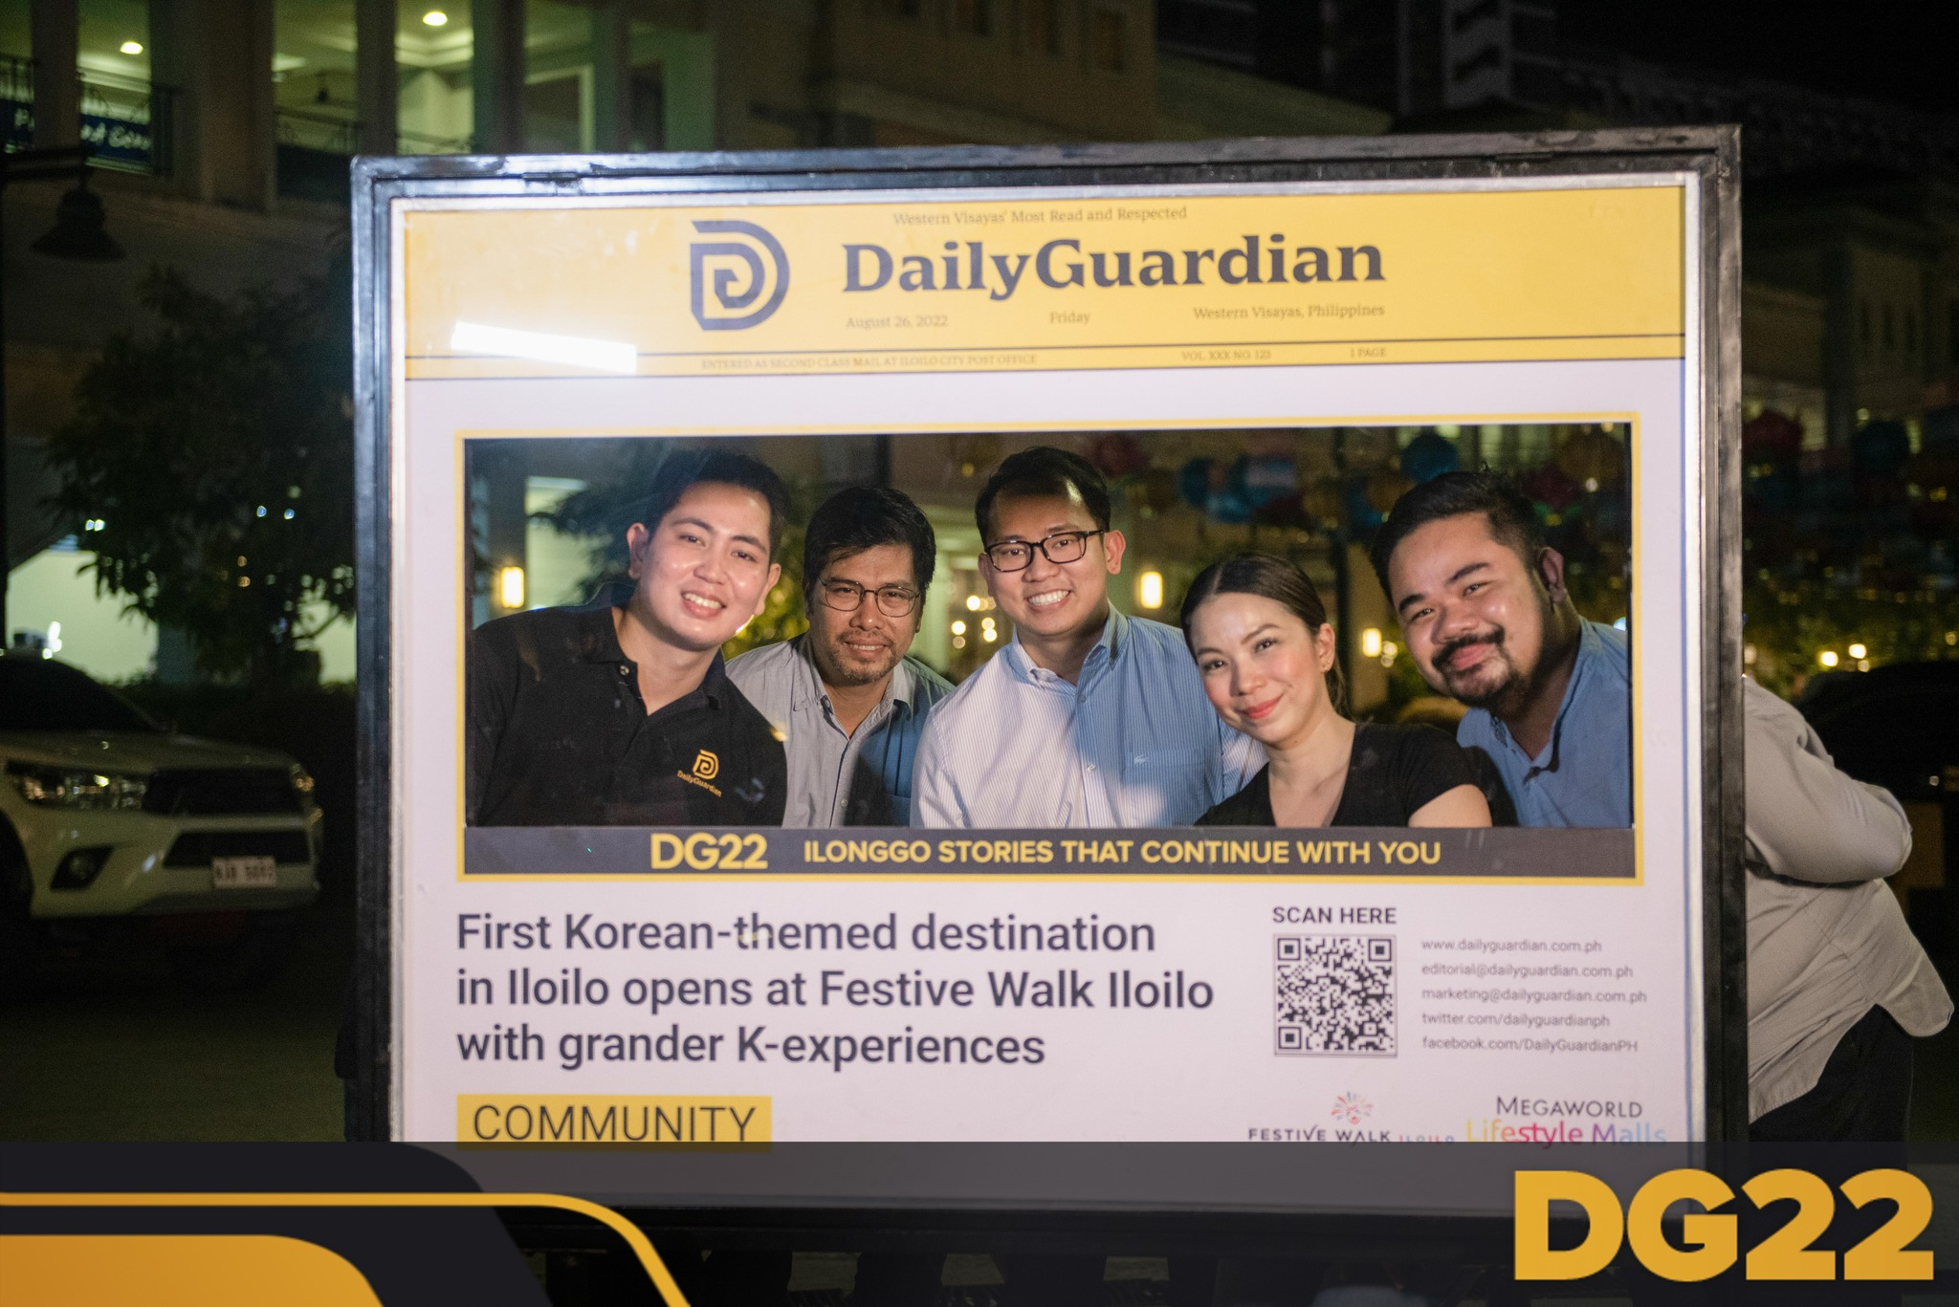
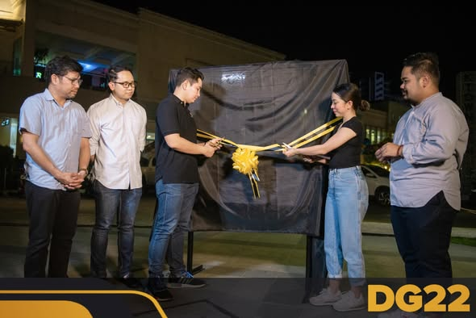
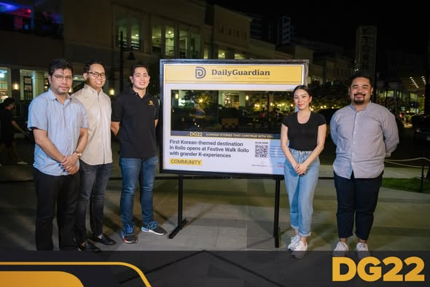
SAMPLE SLIDE ONLY:
NOTE: You may attach photos, links, or any supporting materials in relation to the project. Kindly provide a short description about the attachment provided.
As a part of its 22nd anniversary celebration, Daily Guardian unveils a historical marker at K-Town in Festive Walk Parade. Since its opening on August 26, 2022, K-Town has transformed Festive Walk Parade into a vibrant Korean hub. Daily Guardian celebrates this event with a historical marker, and invites everyone to scan the QR code to read the full article.
More photos from the event here: https://www.facebook.com/share/p/1KogKqd17b/
Notes:
1. The Shield
The shield represents protection, integrity, and responsibility to reflect both the mission of Daily Guardian and the purpose of the Green Guardian initiative.
By anchoring the logo in the shape of a shield, the design communicates its commitment to defending the environment, upholding truth, and safeguarding the public.
2. The Pen Nib
Embedded within the design is the shape of a pen nib, a universal symbol of journalism, writing, and truth-telling. It anchors the logo to Daily Guardian’s identity as a news organization and that of environmental protection . The pen nib may also be interpreted as a guiding light or beacon, a lighthouse.
3. The Leaves
The leaves introduce the element of nature and sustainability. Their presence softens the more formal lines of the shield and nib, and reminds us of the environmental mission of the award.

Slide 5

Celebrating Sustainability and Ecological Innovation in Iloilo

